Slide 1

GetFit
by Team Life

Slide 2

What is GetFit?
We are promoting “fitness”
We envision a society with a healthy-centered lifestyle

Slide 3
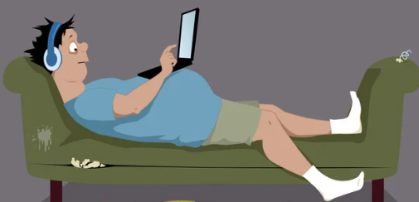
What is the urgency?
67% are less active today ⁽¹⁾
Filipino youths rank second in the world on physically inactivity⁽²⁾
https://www.rappler.com/brandrap/health-beauty-and-wellness/less-exercise-filipinos-covid-19-pandemic-anlene-survey/
https://newsinfo.inquirer.net/1193821/who-ph-youths-2nd-most-inactive-next-to-s-koreans

Slide 4
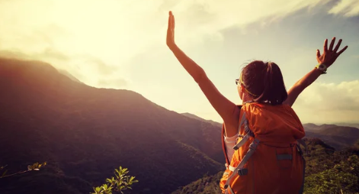
Contribute an initiative that encourages and motivates people to adopt an active lifestyle
Addressing the challenge

Slide 5

Establishing the community
Build a community of health-focused users
Partner with business establishments deemed to promote a healthier lifestyle

Slide 6
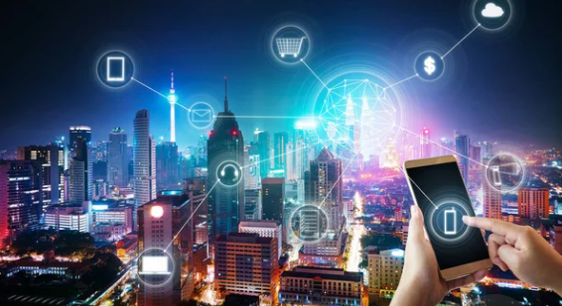
Introducing GetFit
An app that encourages and motivates users to adapt a healthier lifestyle
Rewards users the more active they are

Slide 7

Life coins: the heart of GetFit
Earn life coins on health related activities
Exercising – pedometer tracking
Visiting participating merchants – QR scanning
Use the life coins
Claim discount vouchers
Participate in events
Withdraw life coins to wallet

Slide 8
GetFit Architecture
Ethereum
GetFit Initialization
- Minting of life coins
- 2 trillion life coins
2. Sends coin to user wallet
User 1
GetFit Server
ETH
Wallet
ETH
Wallet
1. Sends Withdrawal
Request
GetFit
App
GetFit
DB
GetFit App
- Earn Life Coin
- Use Life Coin
- Withdraw

Slide 9
Demo

Slide 10

GetFit Benefits
A fun and rewarding experience to stay fit and healthy
Get special offers from merchants aligned with the theme
Sustainable program – Partnership with businesses to develop targeted marketing campaigns to the right audience

Slide 11
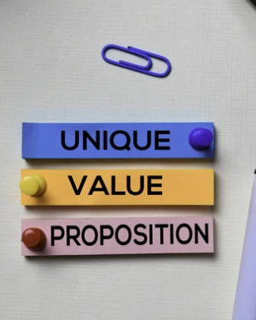
A Unique Value Proposition
Designed with a local setting in mind
Niche segment paves the way towards developing targeted programs and initiatives
Ease of WEB3 onboarding to the non-technical public

Slide 12

Roadmap
GetFit Initial Rollout – Pedometer, QR Code scanning
Availability of Life Coin Wallet
Partnership with 3-5 establishments
GetFit – NFT Badges and milestones, app challenges
AMM Pool
Increased partnerships with merchants – target 10-20
Offer premium partnership with merchants
GetFit – NFT avatars, social community
Offer more programs for cross business
Partnership with special event organizers

Slide 13
Thank You

Slide 14
Backup Slides

Slide 15

A health-focused ecosystem
Exercise & Fitness
Food & Nutrition
Social Activities

Slide 16
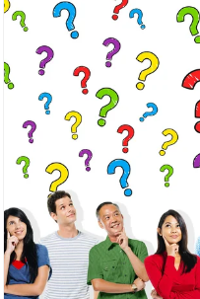
Factors Hindering an Active Lifestyle
Frequent use of mobile phones
Scarcity of safe and open public spaces
Poor urban and transport planning
Pandemic-resulting lifestyle – WFH

Slide 17

Looking for a Solution
The key is to move more!
Latch and leverage on mobile phones
Plenty of clean, safe public spaces – shopping malls
Develop a habit of walking
Lastly, make it fun and rewarding

Slide 18

A Nationalistic Concern
“The fact that the Philippines was at the top of the list is alarming and immediate action should be taken to address this problem”
– Sen. Sonny Angara⁽¹⁾
https://www.onenews.ph/articles/probe-sought-on-youth-s-sedentary-lifestyle

Slide 19
A Nationalistic Concern
Philippine Youth Development Plan 2017-2022 has recommended the creation of programs and projects that promote an active lifestyle and encourage positive nutrition practices. ⁽¹⁾
https://www.onenews.ph/articles/probe-sought-on-youth-s-sedentary-lifestyle

Slide 20

Let Life Coin be your companion on the MetaVerse

